Slide 1
Improving Lives for Youth based on Evidence
PROFESSOR INGA DORA SIGFUSDOTTIR

Slide 2
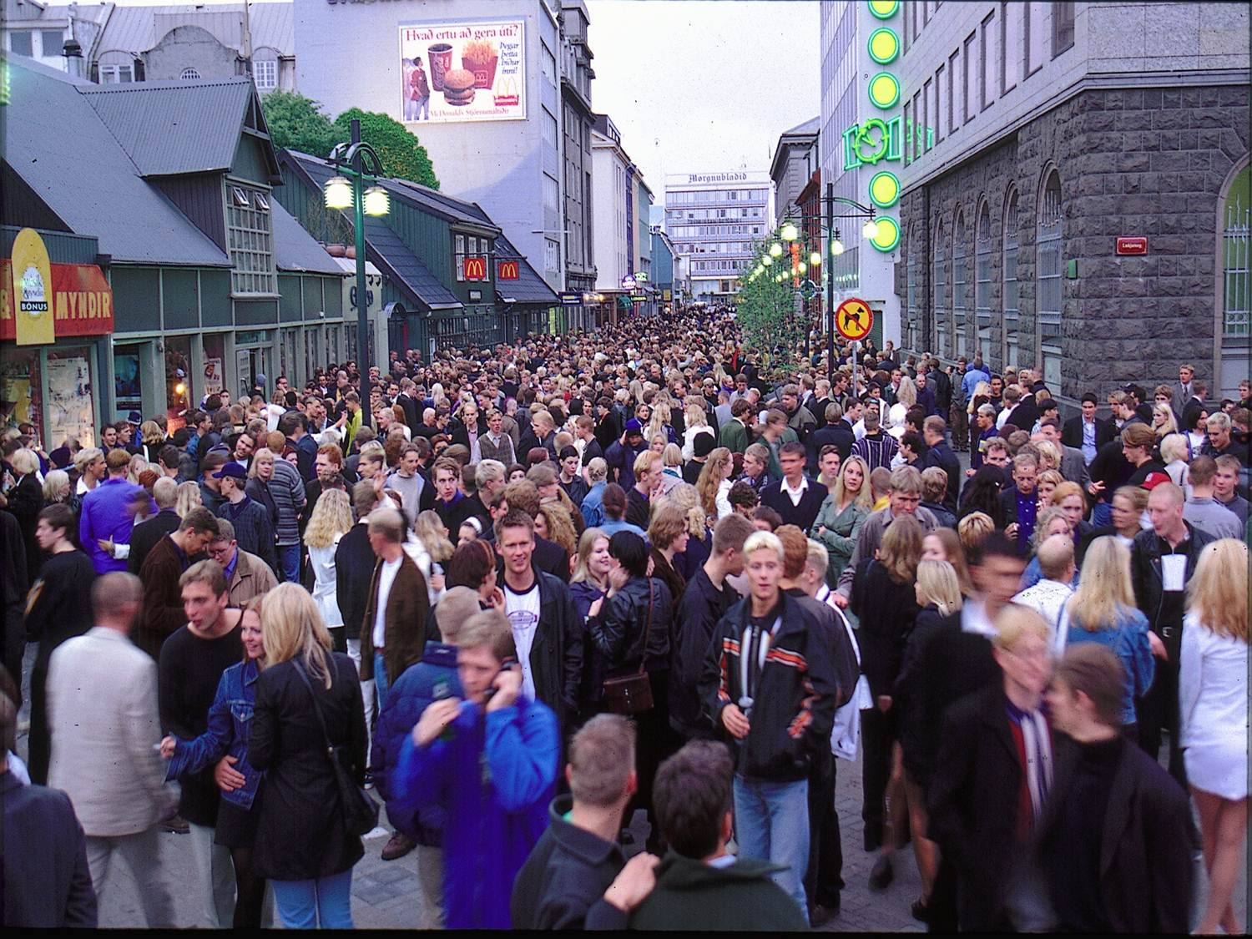
Notes:
The year is 1997;
Saturday night in June;
The clock is 3 AM; (don´t be fooled by the daylight – an Icelandic summer night).
Downtown Reykjavik is full of adolescents – intoxicated adolescents.
At the time - over 40% of Icelandic adolescents have become drunk in the past 30 days.

Slide 3
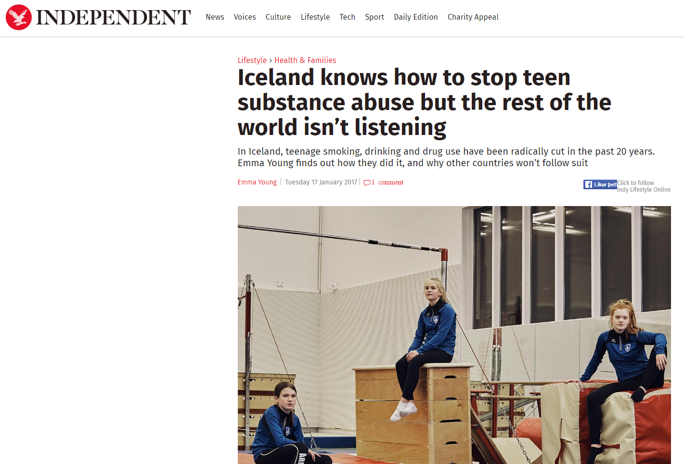
The Atlantic
Notes:
Twenty years later; January 2017:
Iceland makes the headlines in world news.
How Iceland got teens to say no to drugs.
I want to tell you what happened in between those 2 time points;
The story starts in 1997:

Slide 4
1997: Smoke daily, Drunk past 30 days, Have tried hashish
Notes:
42% of 15 year old adolescents have become drunk in the past 30 days.
23% are daily smokers.
17% have used hashish once or more in their lives.
And I tell you – it was not as if nothing was being done. There were numerous prevention projects being carried out!
Most of them focusing on educating adolescents about the negative sides of substance use, -
All having one thing in common; they were not based on data.
None of them using research as a base for the work.
And things were not right;
(Alcohol use, smoking and the use of other drugs was constantly rising among 15 and 16 year olds.)
We obviously needed a new strategy.
At the time a visionary group of researchers, policy makers and practitioners working with children and adolescents decided to gather their strengths, try out a new approach and see whether it might be possible to reverse the negative, upward trend in substance use among young people.
The project was called Youth in Iceland.
It has 3 CORE ELEMENTS:

Slide 5
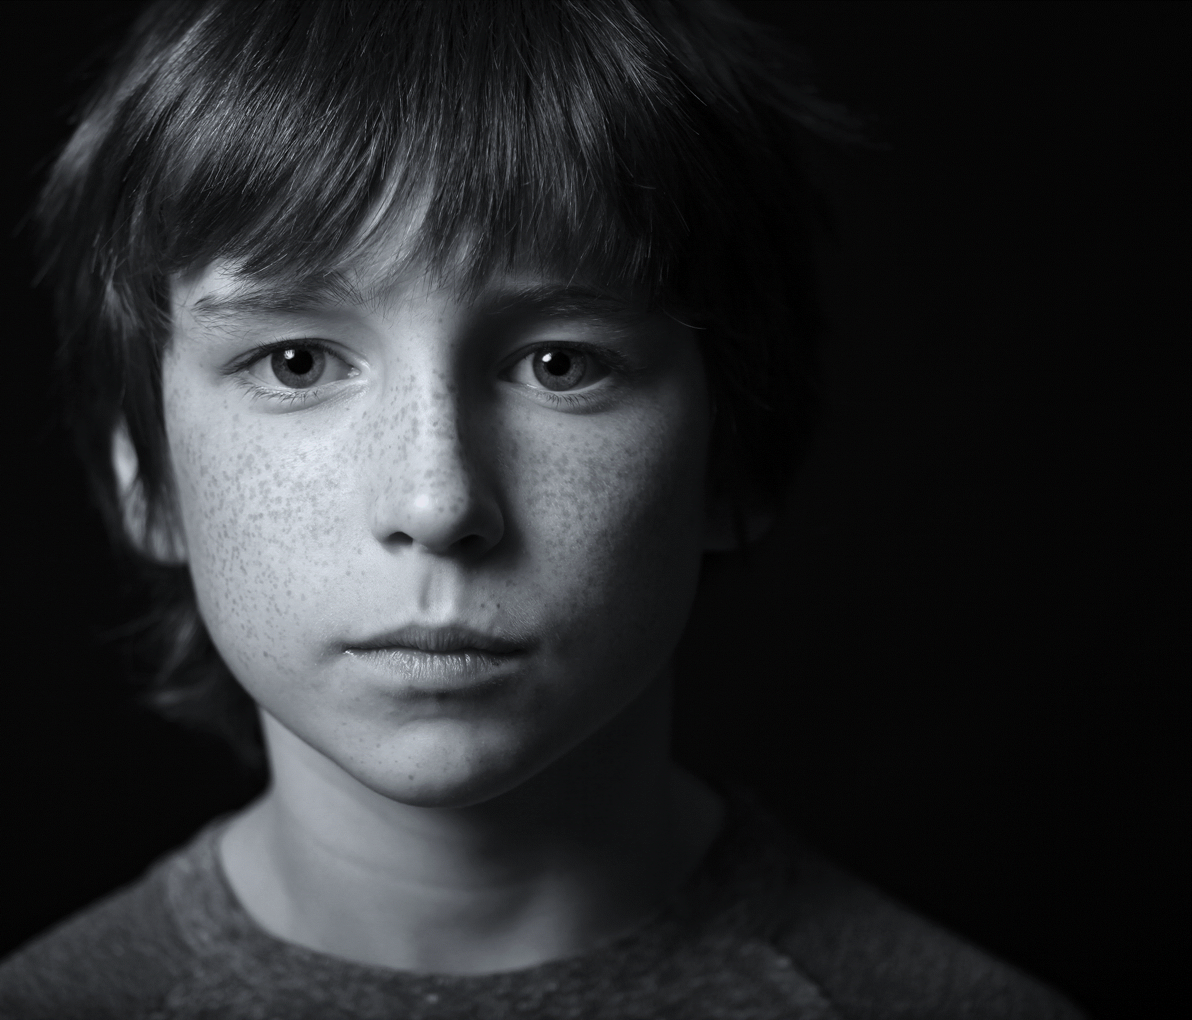
Youth in Iceland core elements:
Evidence base
Community approach
Research – policy – practice: dialogue
Notes:
Evidence! First and foremost – we need to understand what indeed we were dealing with; We need to understand young people – and the world they live in;
To understand what predicts adolescent substance use – and use the evidence to strengthen the protective factors while minimizing the risk.
Far too many policies and prevention efforts have been written and carried out with no or even negative results, since they were not based on understanding and knowledge of the people or issues they were supposed to affect.
They were not based on solid research.
The second core element; was using a community based approach; focusing
on changing the social circumstances of young people – within each community – neighborhood – city.
Not trying to change all at once in a country, - but within a country focusing on cities/communities - and basing the work on research findings for each of these communities.
The third key factor – was to create a dialogue between research, policy and practice. Getting each of these valuable parts out of their own comfort zones – and into a dialogue.
We wanted to change what we believed looked too much like this:

Slide 6
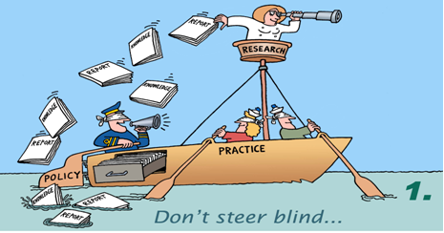
Notes:
…. where research - policy - practice are three separate aspects; with scientists publishing their findings: not knowing, and often not caring much, whether they´d come of any use in society.

Slide 7
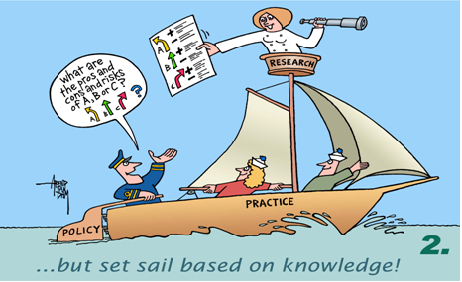
Notes:
Into this; - where people combine their efforts and knowledge to create a system that can benefit young people.

Slide 8
ANALYSIS
Notes:
First and foremost – we needed to understand what indeed we were dealing with;
We needed to understand young people – and the world they live in;

Slide 9
ICELANDIC database 1997 – 2017
Data collections in schools
10 – 13 year old
14 – 16 year old
16 – 20 year old
Notes:
So we started carrying out studies among young people, -
…and we studied and learned. A lot.

Slide 10
Proportion of students in 10th grade who have become drunk 10 times or more during last 12 months (ESPAD, 1995)
Notes:
For example that Icelandic adolescents, along with their Scandinavian and British peers consumed alcohol differently than other European teenagers.
Slide.
Whereas 1, 2, or 3 percent of 15 year olds in southern Europe had become drunk 10 times or more, the proportion among their Icelandic peers was over 20%.

Slide 11
Proportion of students in 10th grade who have had accidents or injuries related to alcohol use (ESPAD, 1995)
Notes:
Similarly – unwelcome incidents, like accidents or injuries related to alcohol consumption were more common in Iceland than in most other European countries.
A part of the explanation was a very liberal view towards adolescent drinking that was found in Iceland, - and needed to be changed.

Slide 12
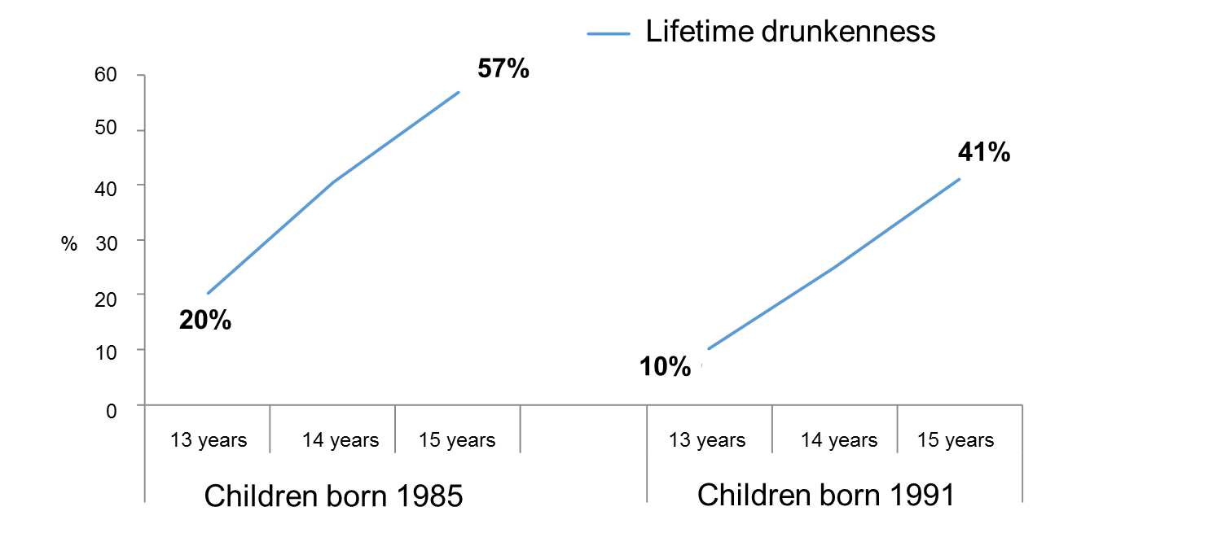
Substance use follows cohorts
Sigfusdottir et al., 2011, Global Health Promotion
Notes:
We also learned that variations in substance use can be predicted, as they follow cohorts. (A cohort that measures above average in substance use at the age of 14, keeps up the use through high school, - and is also heavily using substances around the age of 18. However, a 14-year-old cohort that starts lower – also ends adolescence with lower substance use.)
Message to policy makers: It is very important to: postpone the moment in the lives of young people, - when they have their first drink:
We need to reach them early. Reach the parents of young kids.

Slide 13
Percentage of students in 9th and 10th grade who have become drunk in the last 30 days depending on if their friends become drunk one pr. month
Notes:
And we examined the key risk and protective factors;
The studies revealed that affiliations with family, peer group effects and types of recreational activities available are the strongest predictors, of the path taken by adolescents.
Like studies elsewhere have shown, - the influence of the peer group is negative. No matter how we look at it, - having friends that drink, smoke hashish, or use other drugs, increases the likelihood of similar behavior among the adolescents themselves.

Slide 14
Percentage of students in 9th and 10th grade who smoke daily depending on if they practice sports
Strong connection between smoking and participation in sports
%
Notes:
On the contrary, the influence of extra-curricular activities is beneficial, - the more time adolescents spend in organized youth work or sports, the less likely they are to smoke, drink and use other drugs.
The more time adolescents spend together in unstructured activities, - away from guides and role models who encourage youth to invest in conventional culture, the more likely it is that they are willing to partake in substance use.

Slide 15
Percentage of girls in 9th and 10th grade who have become drunk in the last 30 days depending on how much time they spend with parents
Strong connection between drinking alcohol and time spent with parents
Notes:
The role of parents is vital. Slide. Both do they decrease directly the likelihood of substance use – BUT more importantly they also affect friendship choices.
Three parental factors seem to be of most importance:
Perceived emotional support – Monitoring - Adolescents whose parents know where they are and with whom, are less likely to use drugs, than adolescents who are monitored less.
The third family factor of great importance turned out to be the AMOUNT of time spent with parents. The MORE time adolescents spend with their family outside of school the less likely they are to use drugs.
This subtle finding was extremely important in Icelandic circumstances. It has been measured that when given the choice of more leisure or more work, Icelanders have been known for choosing more work.
A nation who takes pride in working long hours and counts every spare hour as an hour wasted needed to hear that the amount of time spent with their children was of importance in hindering delinquent behavior.

Slide 16
ACTION
Notes:
All these findings were used as a foundation for a comprehensive prevention program – that consisted of multiple small and large scale projects on different levels of society.

Slide 17
Policy based on research findings
Time spent with parents
Support
Monitoring
Caring and warmth
Family
factors
Peer group
Unstructureed activities
Sports
Extracurricular at school
Arts
Scout clubs
Organized Youth work
Having friends that use drugs
Attending parties
Spending time downtown
Notes:
By putting less emphasis on education about substances, - or teaching each individual to say NO to drugs, - but instead focusing on changing the social environment of youth, - and through that affecting their behavior.
NGO´S was formed – Their efforts sought to:
Promote collaboration between parents and schools
Encourage parents to spend more time with their adolescent children
Many policy changes were made at the community levels, - within the capital city and across the country. The focus was on reaching out to parents with clear messages related to the findings of the studies: for example, on the importance of spending time together; that all teenagers should be home by 10 o´clock in the evenings and that unsupervised adolescent gatherings should be avoided.

Slide 18
A highly-publicized, annual “Prevention Day” was launched in 2007 by the President of Iceland, the goals of which were to:
One hour a day with family
Some organized sports and youth activities
Wait to drink alcohol until 18 or later
2014 ICSRA │ Reykjavik University
Notes:
The President of Iceland started, a prevention day – with clear messages: sjá glæru.
And there – and always - it was stressed that every participant in adolescents’ lives, - parents, teachers, coaches, cops, need to work together in order to succeed in fighting substance use.

Slide 19
IMPACT
Notes:
/And the tide began to turn;/

Slide 20
Percentage of students in 9th and 10th grade who spend time (often/almost always) with their parents during weekdays
Parents and children spend more time together
Notes:
Adolescents started spending more time with their parents both on weekends and working days.

Slide 21
My parents know where I am in the evenings (applies very or rather well to me) 9th and 10th grade
Notes:
Monitoring by parents increased– Adolescents coming home earlier in the evenings and parents know where they are in the evenings and they are getting more support from their parents.

Slide 22
Percentage of students in 9th and 10th grade that participate in sports in a sports club four times per week or more
Increased participation in organized leisure time activities
Increased participation in organized sports
Notes:
Likewise, participation in organized youth work and sport has increased and unsupervised gatherings are less frequent than before

Slide 23
Percentage of students in 9th and 10th grade who have been out after 10 pm (3 times or more) in the past week

Slide 24
Positive development over 20 years
Notes:
And substance use declined

Slide 27
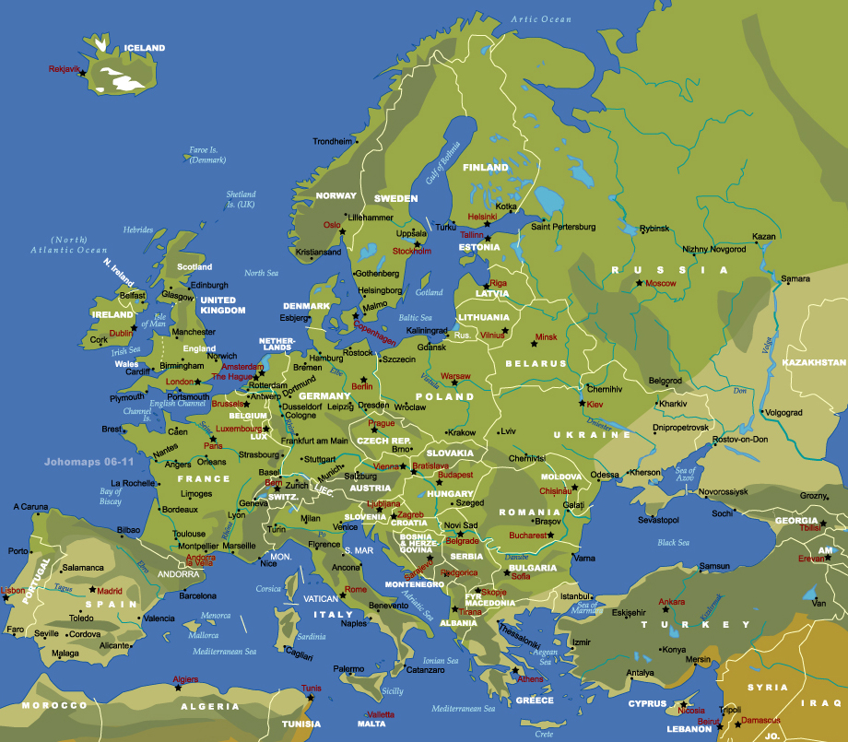
What is the commitment?
35 municipalities in 18 countries
Notes:
For the past years we have had an opportunity to work with colleagues in several cities in Europe; through the Youth in Europe program, where we are figuring out how we can make similar principles work in different places, - by mobilizing local societies – and creating circumstances that can influence the lives of adolescents in a positive way.
It turns out that the model is transferrable.

Slide 28
Notes:
... Riga – Different society – Same model – Similar results.

Slide 29
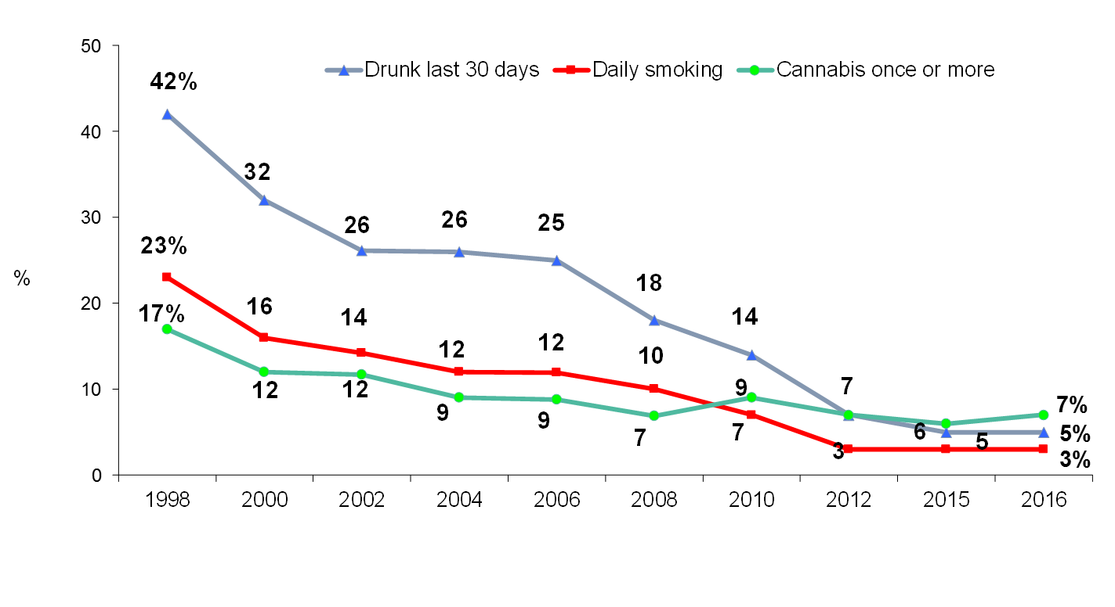
Positive development over 20 years
THANK YOU
Notes:
Dear colleagues;
Today our work is a joint European effort; we want it to become a joint global effort.
In a world, where there are practically no cultural or national boundaries anymore – AND cyberspace is without limits - teenagers are mobile in more than one sense of the word.
In this kind of world, we know that it is only through joining forces, by learning from each other and basing our work on trustworthy research that we will succeed in fighting substance use. It is not an easy task. But based on research – we know it can be done.
Not through single project solutions, - not one campaign - but more as a quiet revolution!

